Slide 1
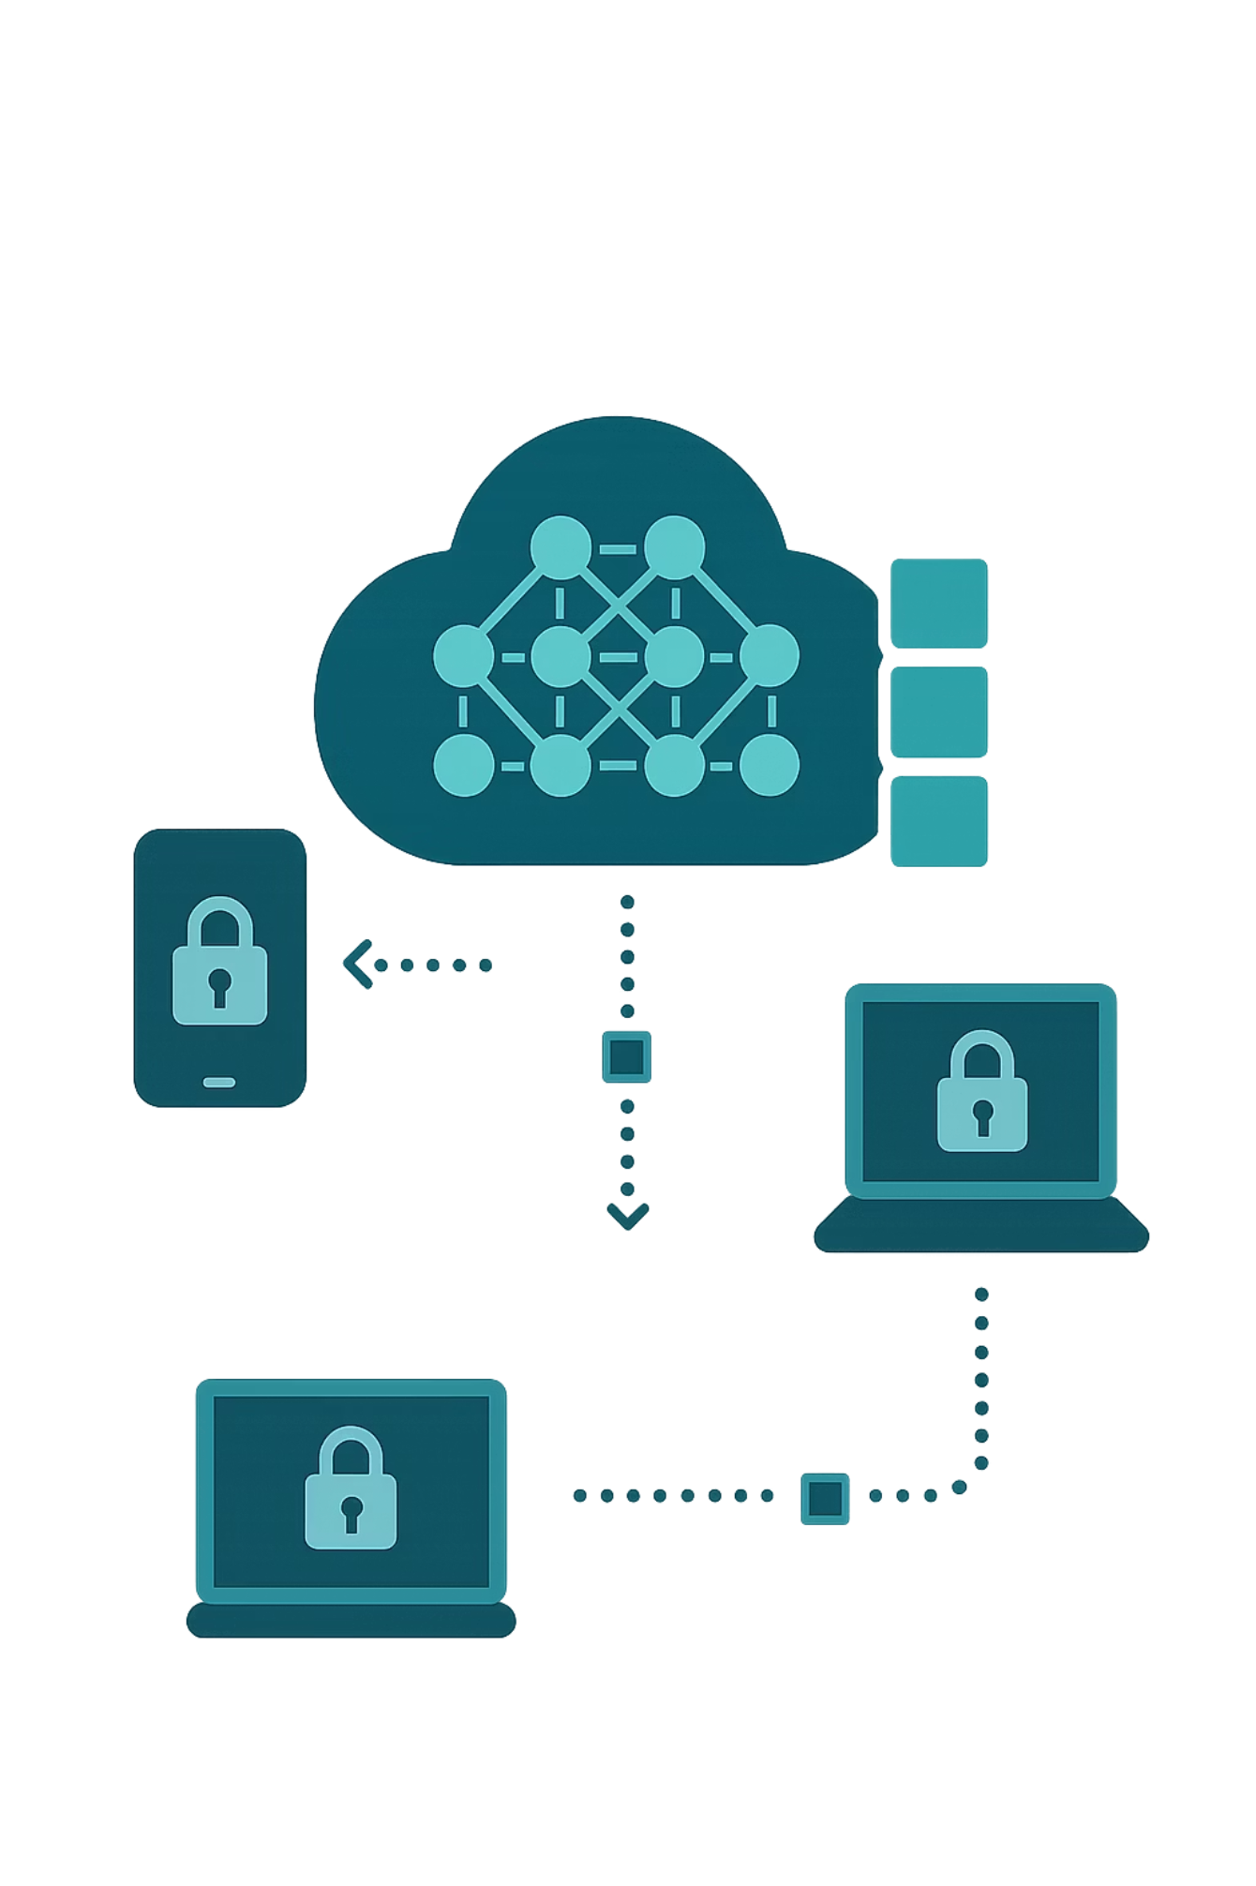

LoRA Privacy Collaborative PEFT via Federated Learning
CS-595- Project Proposal
Presented By:
Atishay Jain
GarvilKumar Shah
Gaurav S.

Slide 2
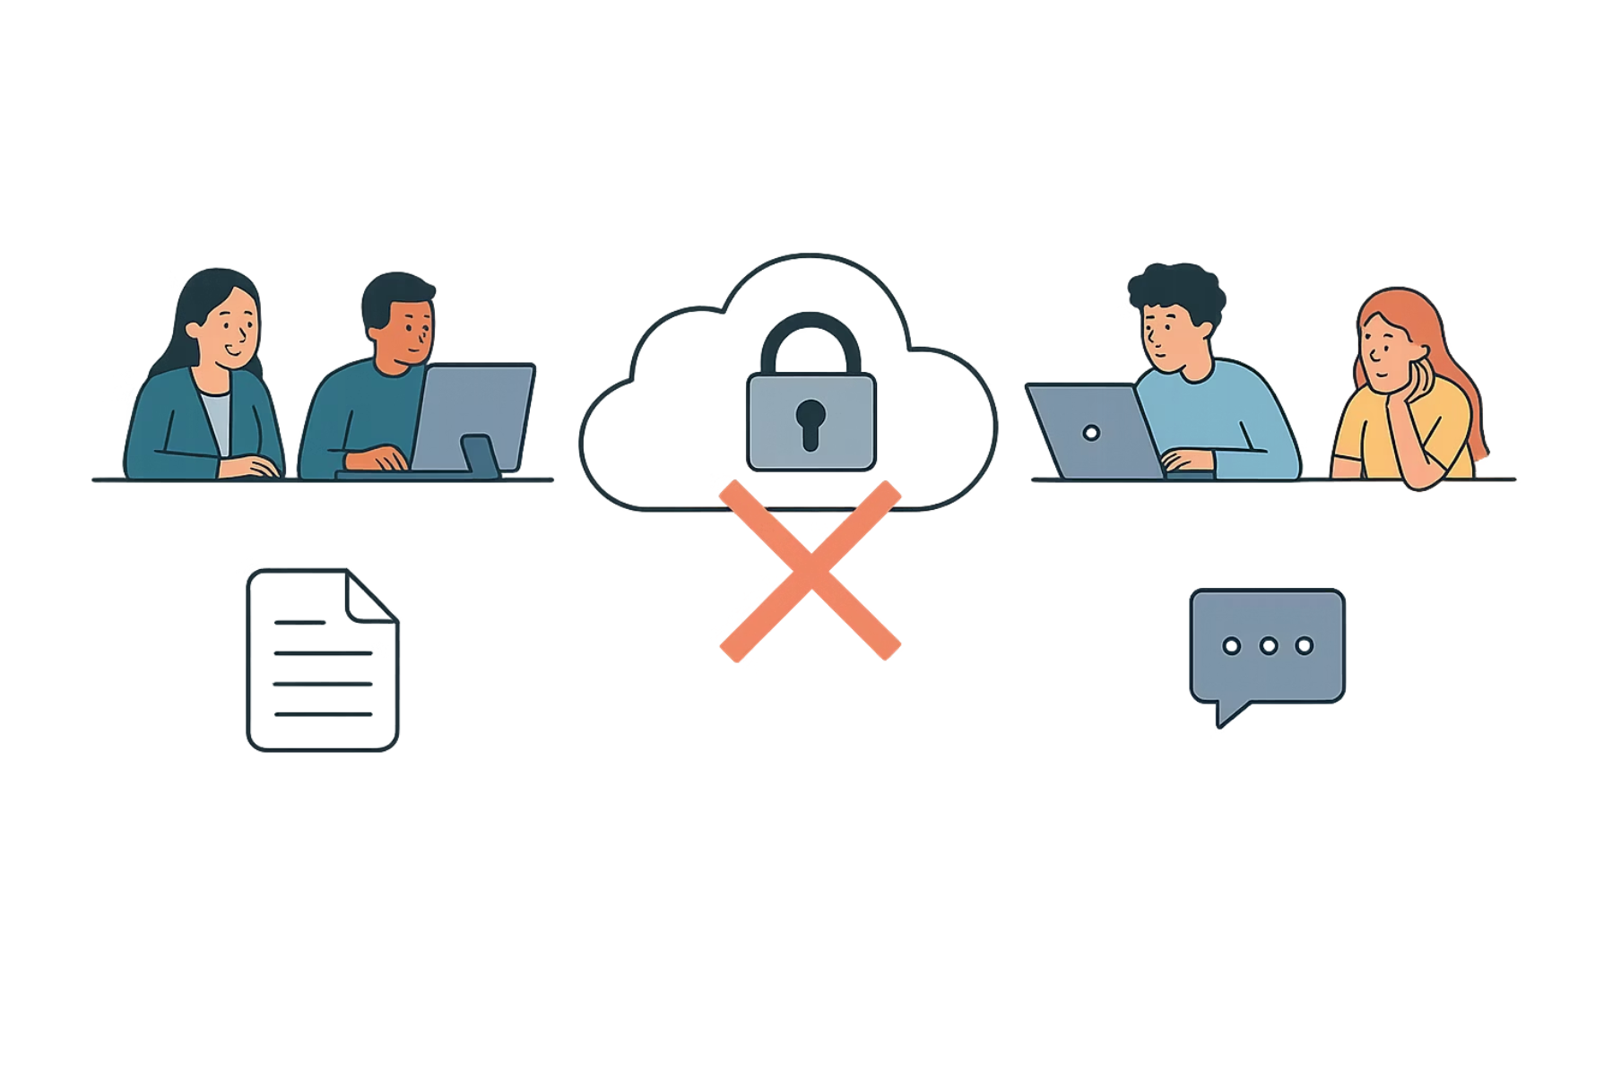

Setting and Motivation - Why Federated LoRA finetuning?
Each department holds valuable data, but it’s locked in silos.
Centralized training is slow, costly, and breaks privacy rules.
Data movement triggers compliance risks and delays.
Result: Stale models, trapped knowledge, and slow innovation.
According to a 2025 Cutter Consortium report, about 34% of organizations are already planning to integrate LLMs, and McKinsey’s latest AI survey calls this the “early days of a massive transformation.

Slide 3
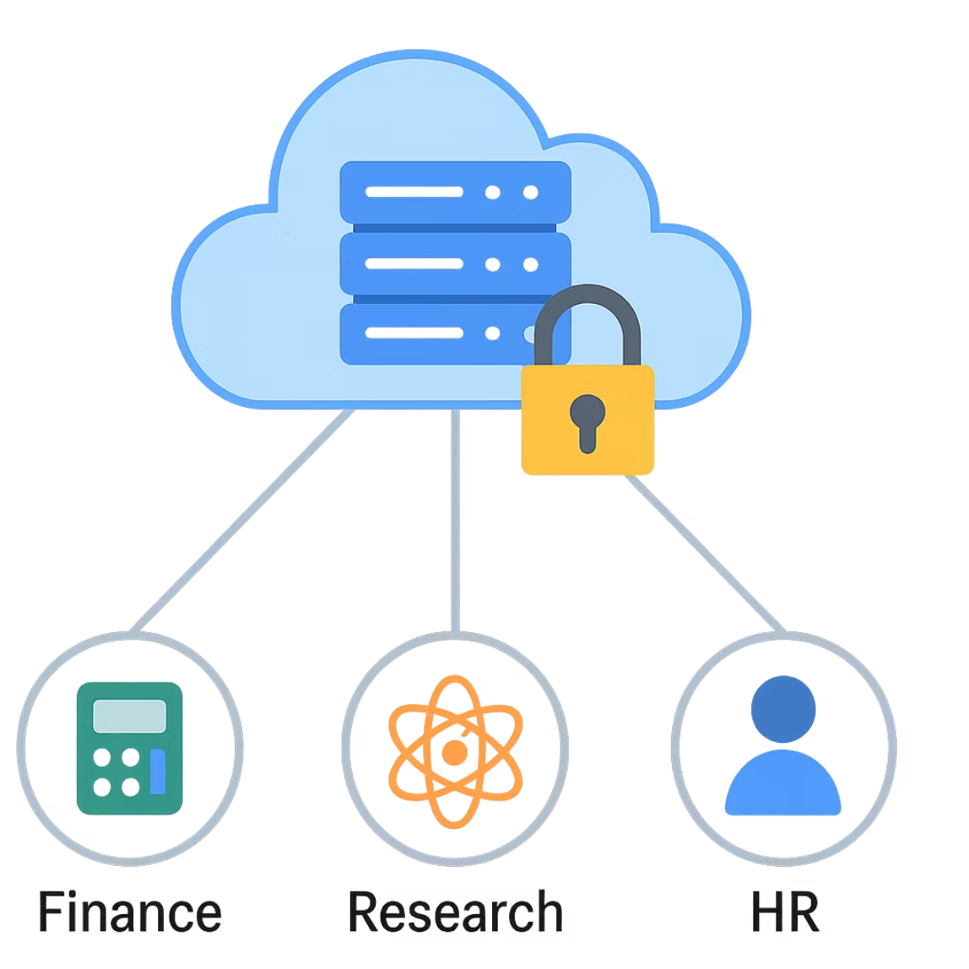
Identification of the Problem
Modern organizations face significant hurdles in leveraging LLMs effectively.
Our approach directly addresses these critical issues - Data Privacy & Security, High Resource Intensity, Scalability Constraints, Operational Inefficiency
The Idea:Train smarter — together, without sharing data.
How:
Local fine-tuning with LoRA adapters
Federated Learning connects departments
Clustered aggregation keeps models personalized
Only small adapter updates (no raw data) are shared
Aim:Study how different LoRA variants affect federated model accuracy, efficiency, and personalization.
Blue Prism reports that 80% of enterprises believe AI will boost productivity, but they struggle to scale training safely and cost-effectively.

Slide 4








Proposed Solution
Our proposed solution leverages a federated learning framework, combining it with efficient PEFT methods like LoRA/QLoRA to overcome data silos and privacy concerns in LLM training.
Distribute Base Model
Local Fine-Tuning
A central server securely distributes the foundational LLM to all participating teams.
Each team fine-tunes the LLM locally on their private datasets using LoRA/QLoRA adapters.
Aggregate & Update
Upload Adapters
The server aggregates these adapters, updates the global model, and redistributes the enhanced model back to the teams.
Only the small, lightweight adapter weights (MBs, not TBs) are uploaded to the central server. Raw data never leaves its source.

Slide 5
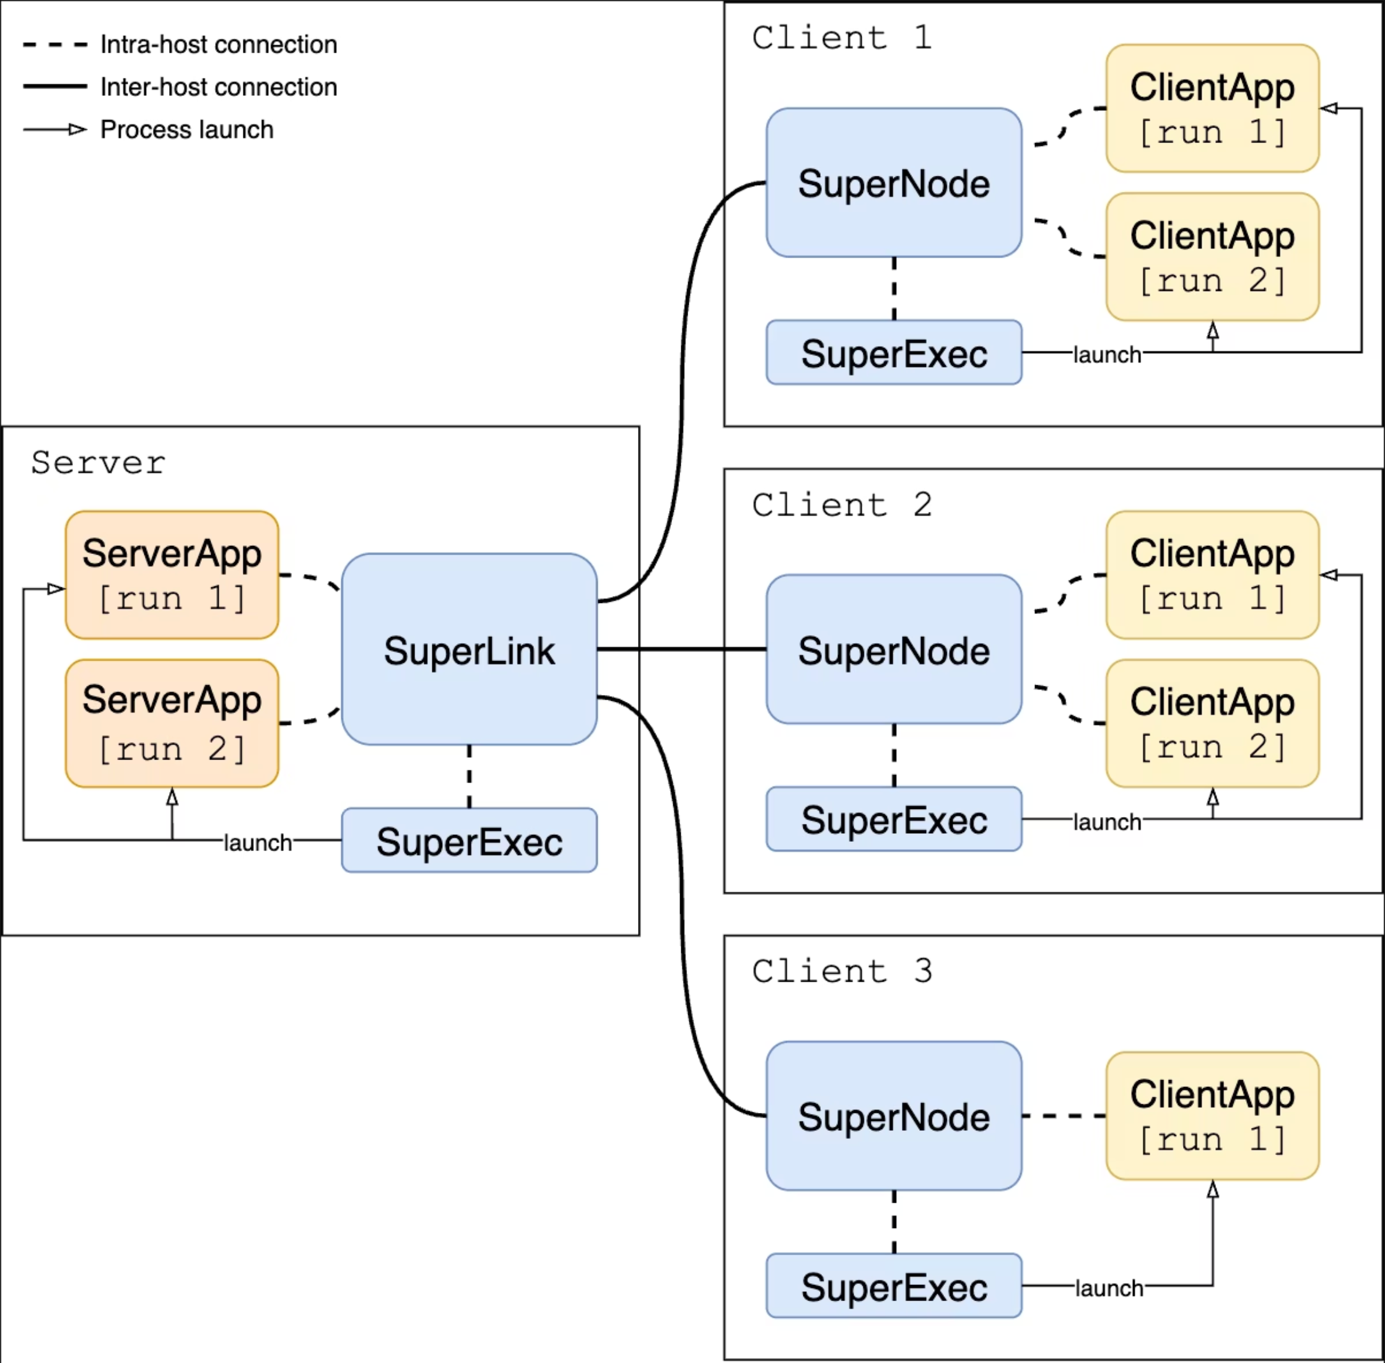
Technical Flow

Slide 6



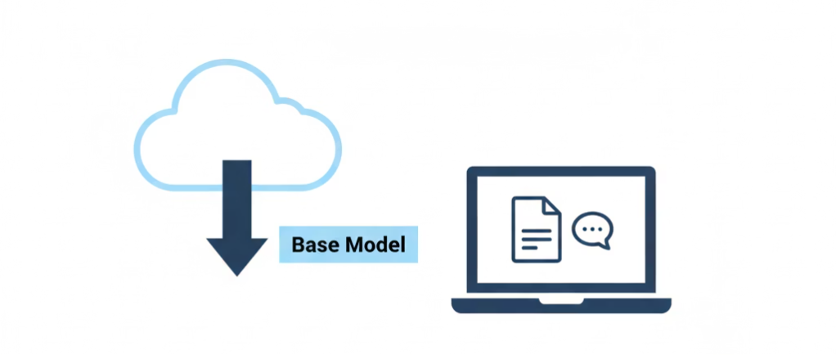
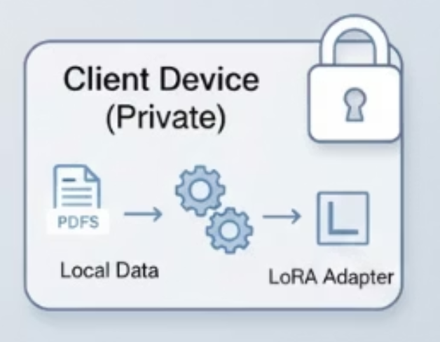
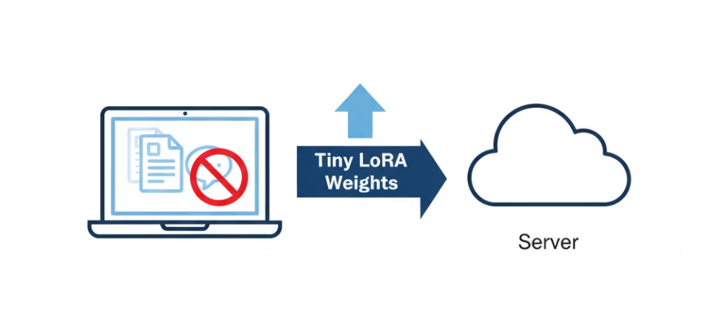
Technical Flow: Client Side
Deploy Base Model
Local LoRA Fine Tuning
Upload LoRA Weights
A small, quantized base model is deployed on the clients local device.
Upload of Learned LoRA Weights
Local LoRA Adapter Fine-Tuning

Slide 7
Comparison With Existing Work
A comprehensive comparison of various LLM adaptation techniques across key features:
Technique
Params Updated
Compute Cost
Storage Footprint
Data Privacy
Adaptability
Use in Federated Setup
Full Fine-Tuning
All model parameters
Very High
Very High (full model copy)
Low (raw data sent to server)
High
Not practical
Prompt Tuning
A few soft prompt tokens
Low
Very Low (a few tokens)
Medium (prompts might contain sensitive info, but not raw data)
Medium
Possible, but limited utility
LoRA (and variants)
Few (adapter weights)
Medium
Low (small adapter matrices)
High (raw data stays local, only weights shared)
High
Excellent
RAG (Retrieval Augmented Generation)
None (base LLM unchanged)
Low
Medium (vector database)
Medium (embeddings might be shared, but not raw data)
High (through document updates)
Possible, but data source integration is complex

Slide 8
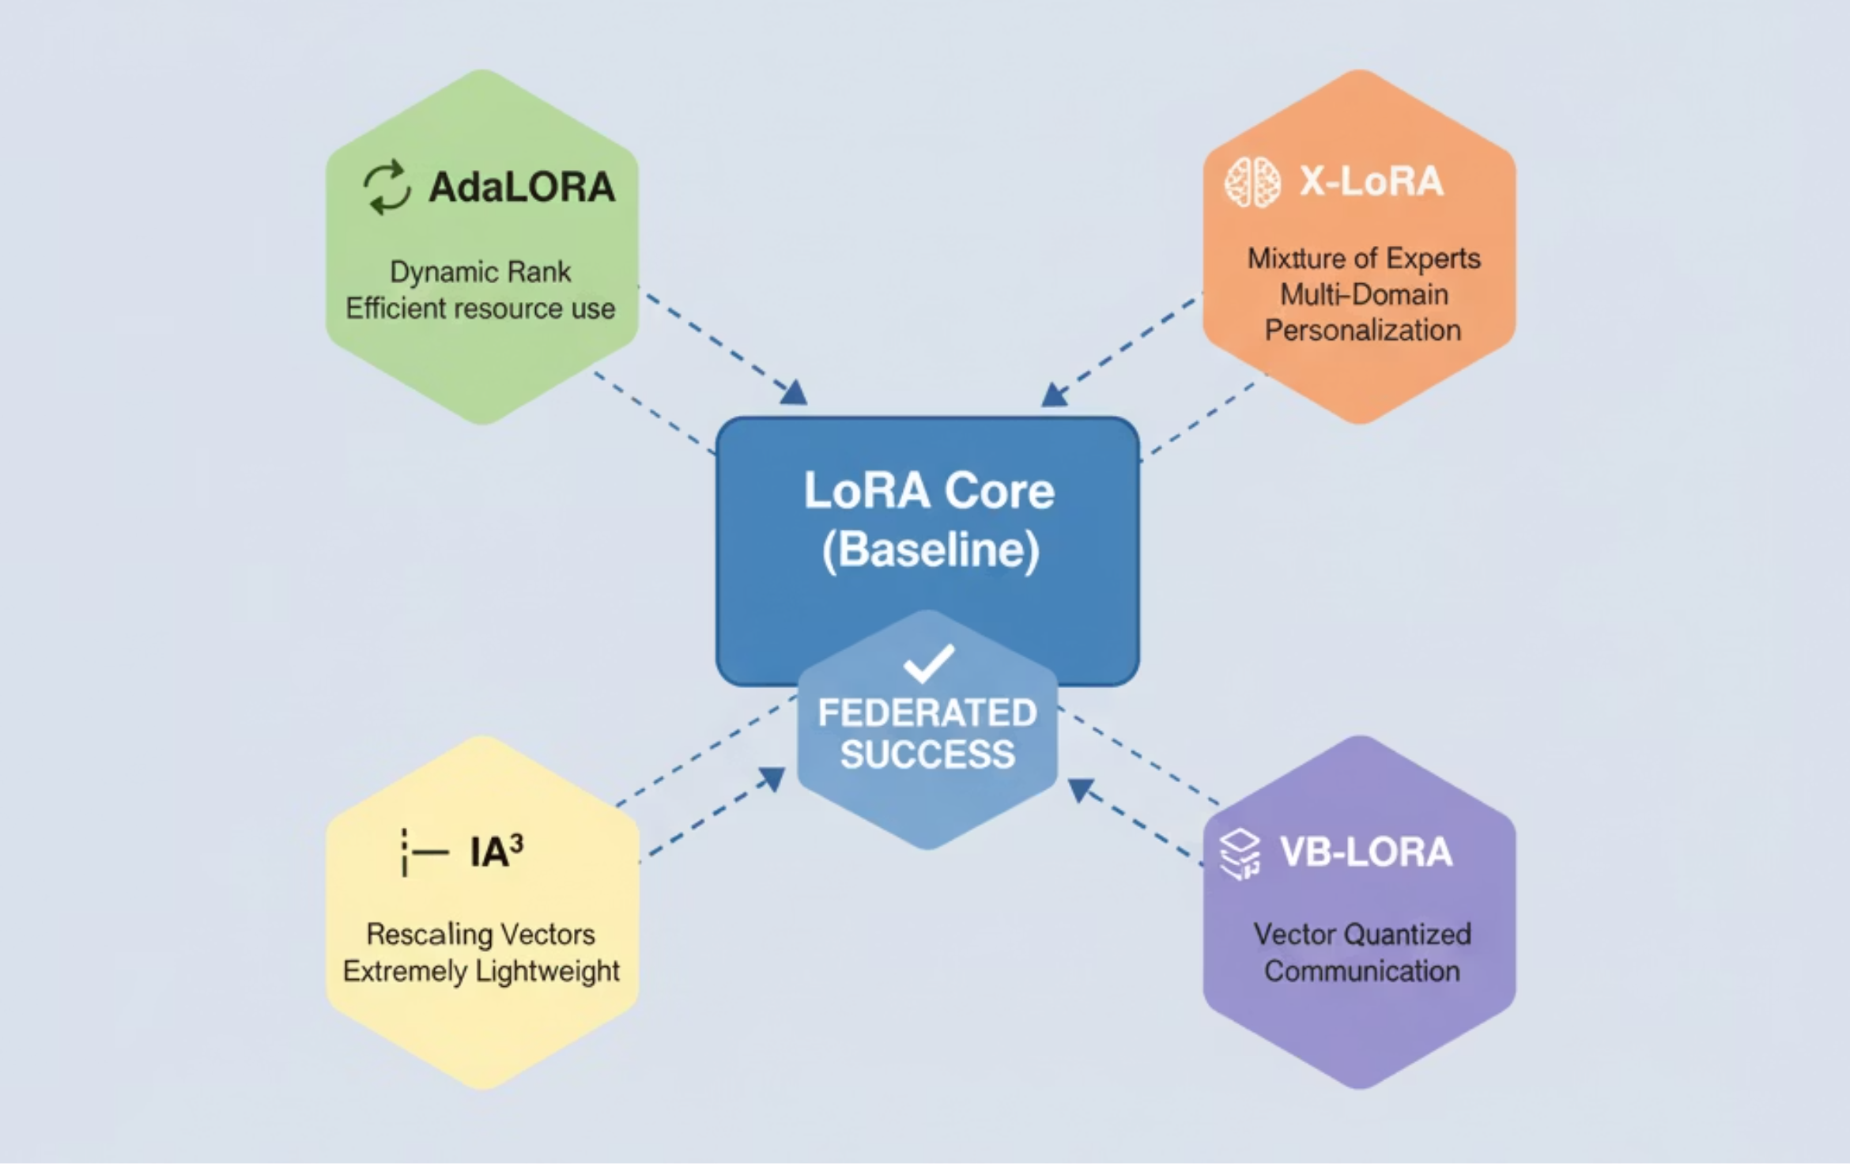
LoRA Variants: Exploring Optimizations for Federated Success

Slide 9
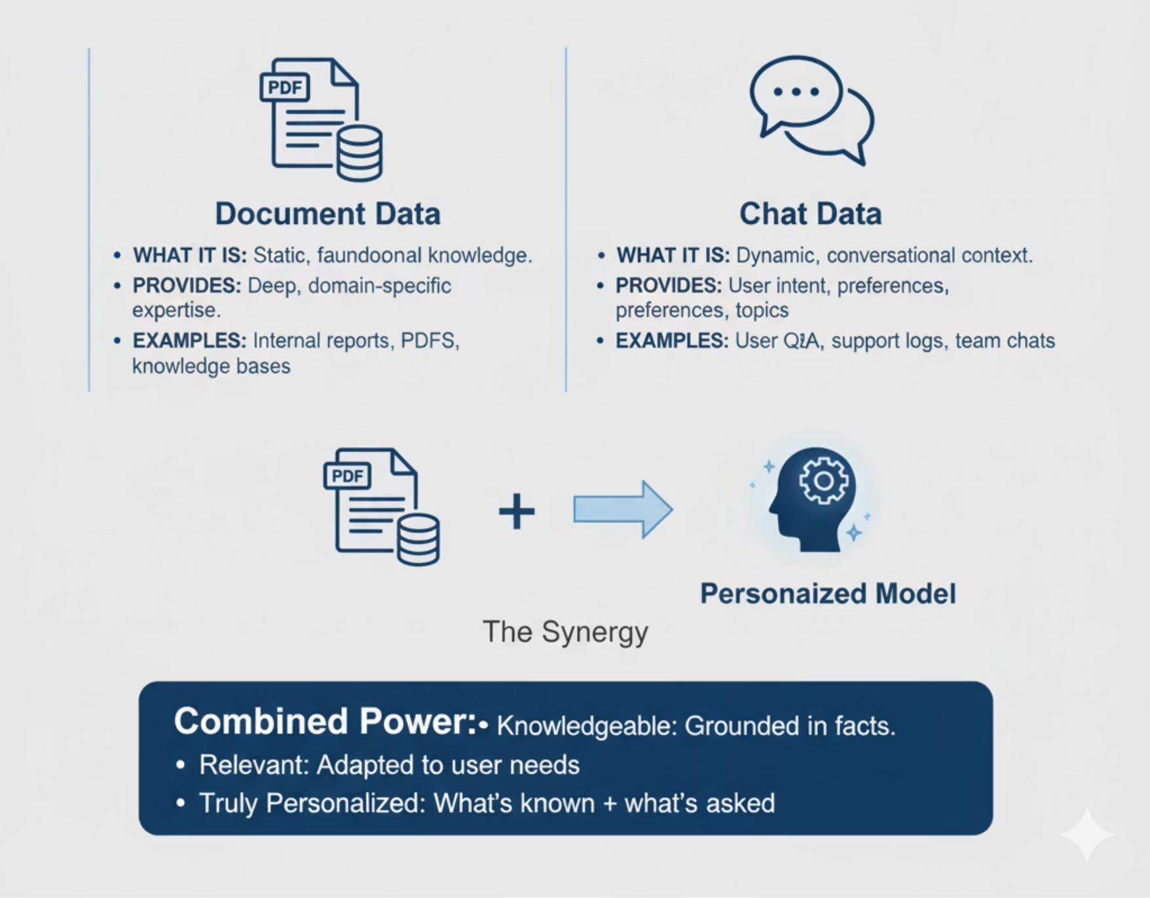
Fueling Personalization: The Nature of Local Data
Tailoring LoRA to our Diverse Federated Environment.

Slide 10
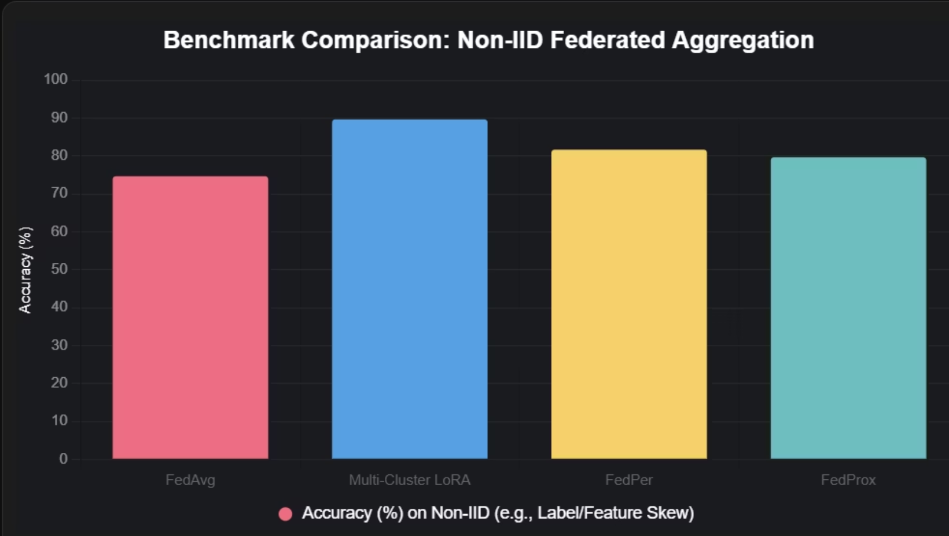
Technical Flow: Server Side - Clustered Federated Learning
This approach groups clients into distinct clusters based on data similarity, often using techniques like K-means on data embeddings. Aggregation then occurs exclusively within these clusters, ensuring each group maintains its own specialized set of LoRA adapters.
Prevents Domain Interference
Efficiency & Scalability
Superior Performance
Privacy & Security

Slide 11
Comparison of Aggregation Methods & Implementation
Method
Handles Non-IID?
LoRA Fit
Privacy/Efficiency
Multi-Cluster LoRA
Excellent
Excellent
High/Medium
Personalized (FedPer)
Good
Medium
Medium/High
FedProx
Medium
Good
High/Medium
FedEx - LoRA
Excellent, but not as good as multi-cluster LoRA
Good
High/Medium

Slide 12
Technology Stack
Parameter Efficient Fine - Tuning (PEFT) library for LoRA and QLoRA configuration
Flower framework for multi-cluster aggregation
Perplexity via Torch Metrics OR GLUE(General Language Understanding Evaluation) benchmarks
Cloud platforms for central integration.
Chameleon for compute.

Slide 13
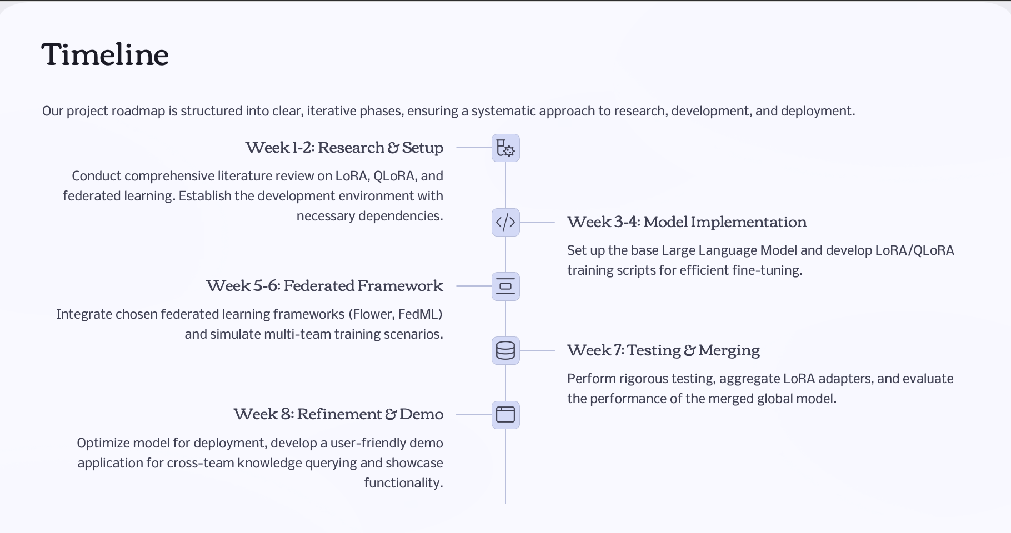


Slide 14
Thank You

